Slide 1



No time for leftovers.

Slide 2





FOOD WASTE IS A BIG WASTE.
WORLDWIDE
ECONOMY
OUR
CLIMATE
NATURAL RESOURCES
BIO-DIVERSITY
Yearly loss of between 780 billion – 1 trillion dollar.
If food loss and waste were a country, it’d be the 3th largest greenhouse gas emitter after China and the US.
Loss of water, oil and land.
Land conversion to agriculture is one of the greatest threats to global biodiversity.

Slide 3
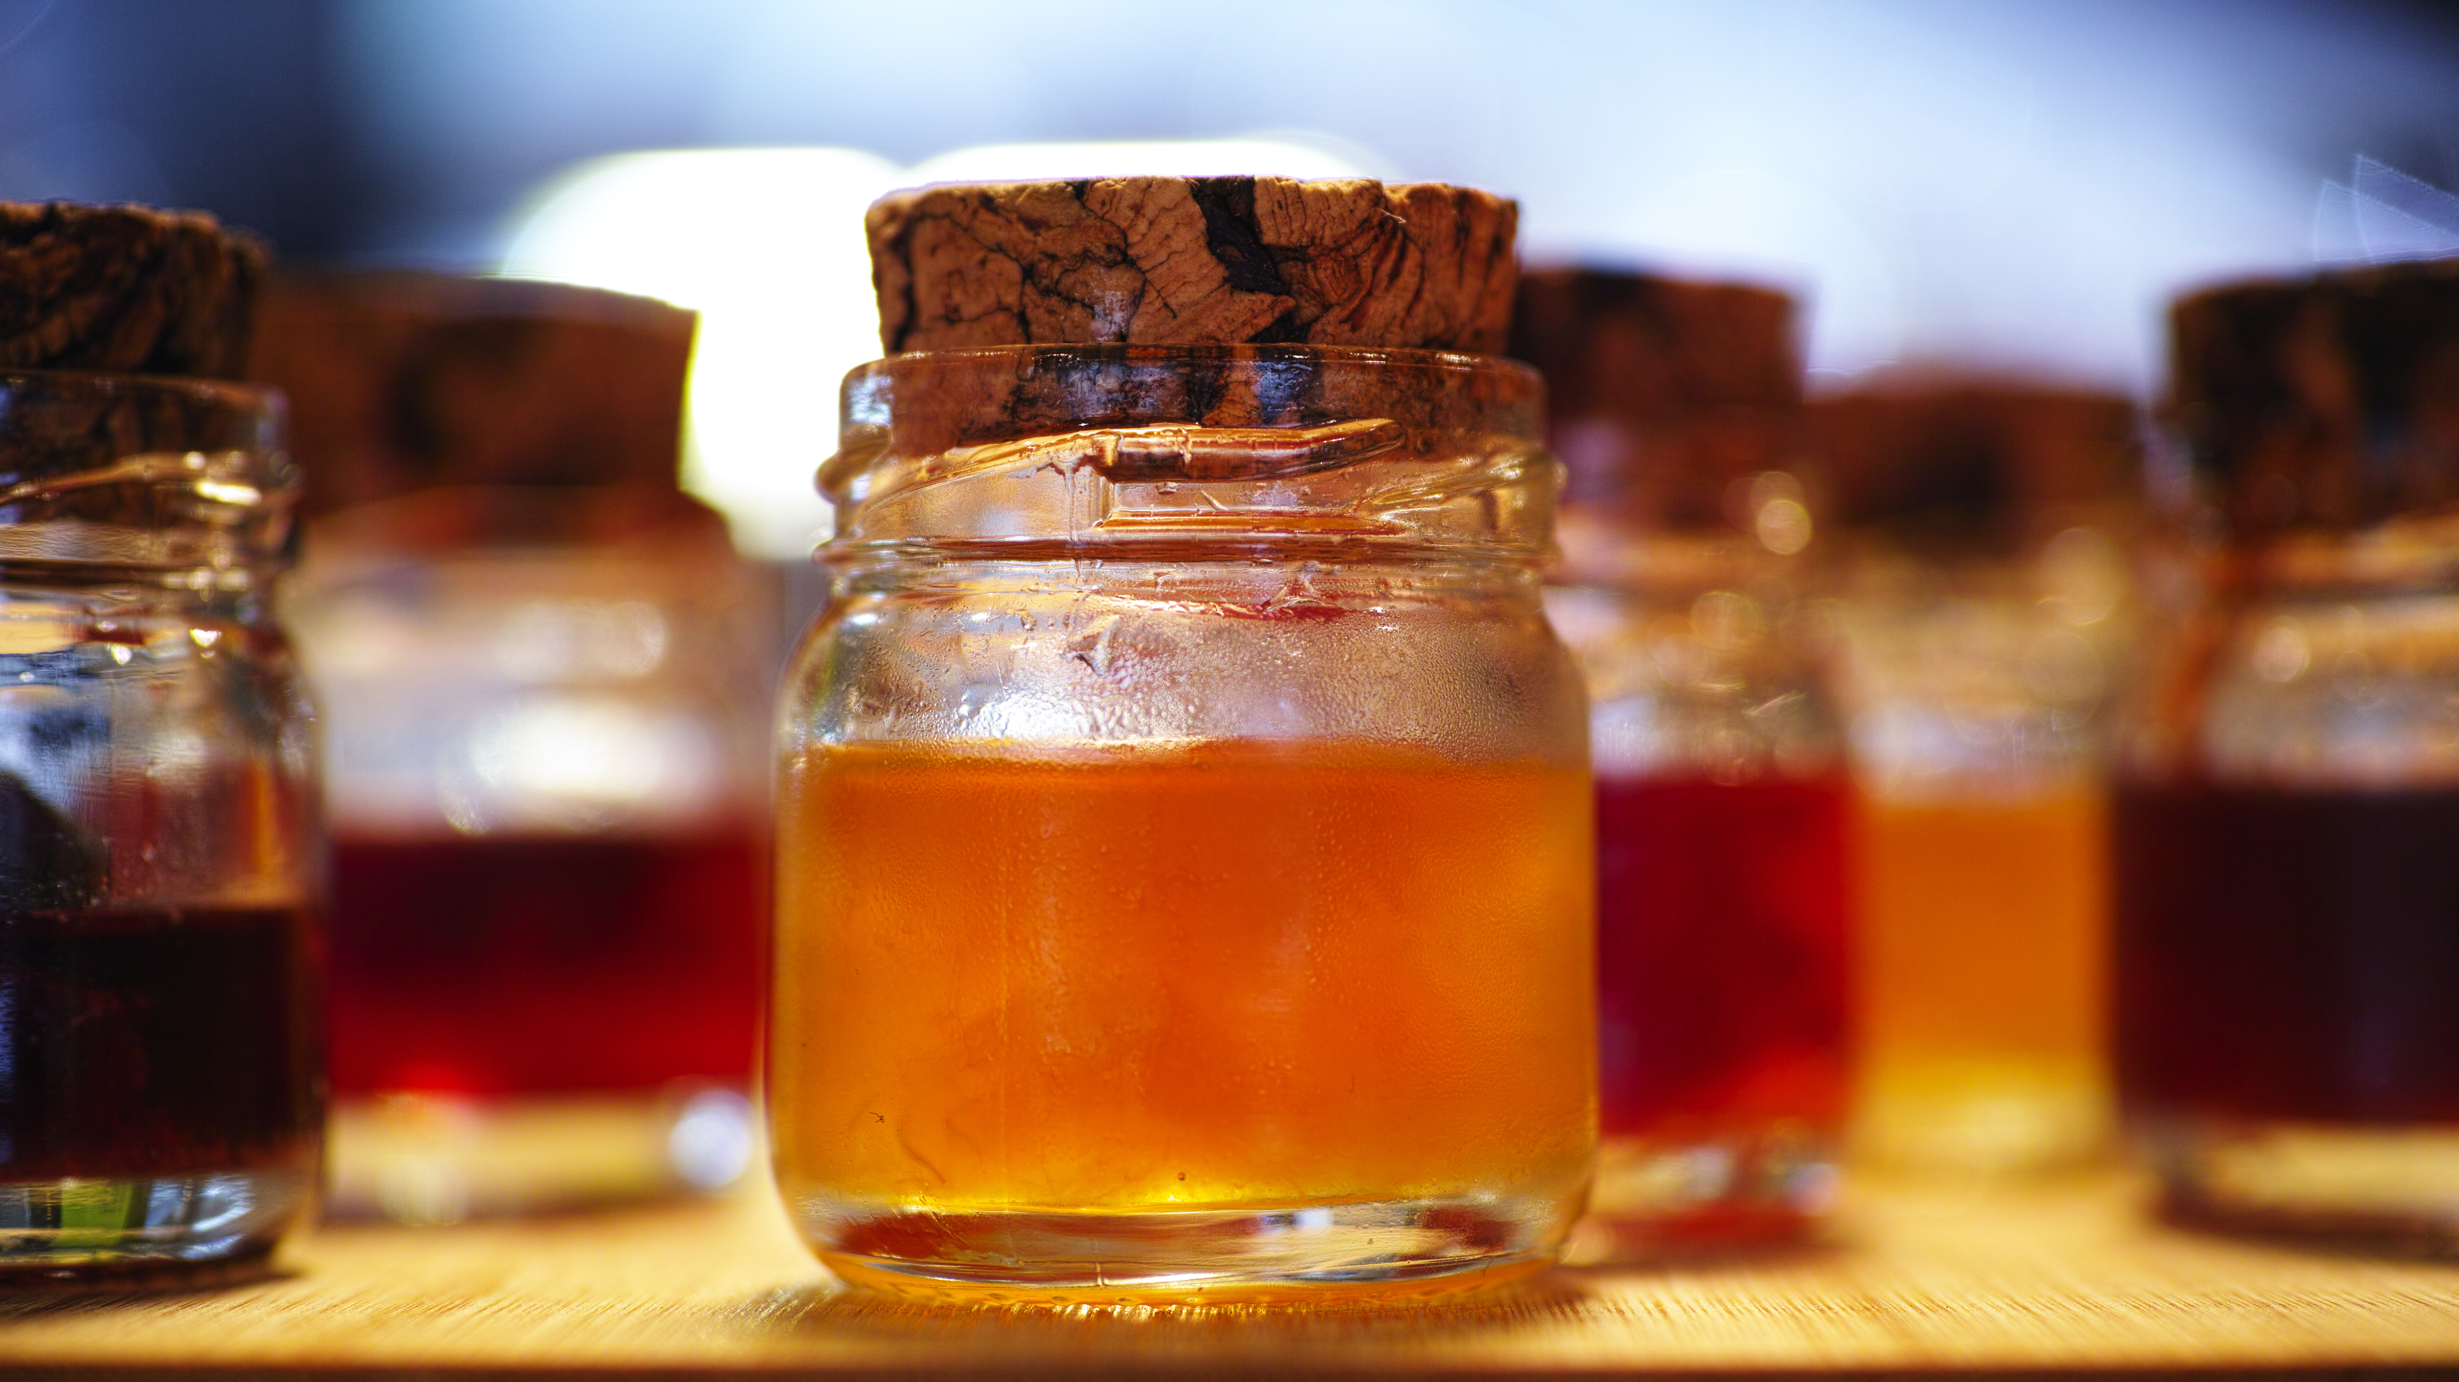

30-50% food is thrown away by the purchaser
We believe that every piece of food in your kitchen has some serious potential.
We all have this one bottle of maple syrup.

Slide 4






What does.
FOODMatters generates a meal plan for a specific period of time with bulk-bought ingredients that will be completely used.
Efficient meal planning with ingredient memory.
Personalized meal suggestions for specific amount of days.
Grocery shopping list based on your selection.
Easy step-by-step recipes with smart kitchen timer .

Slide 5
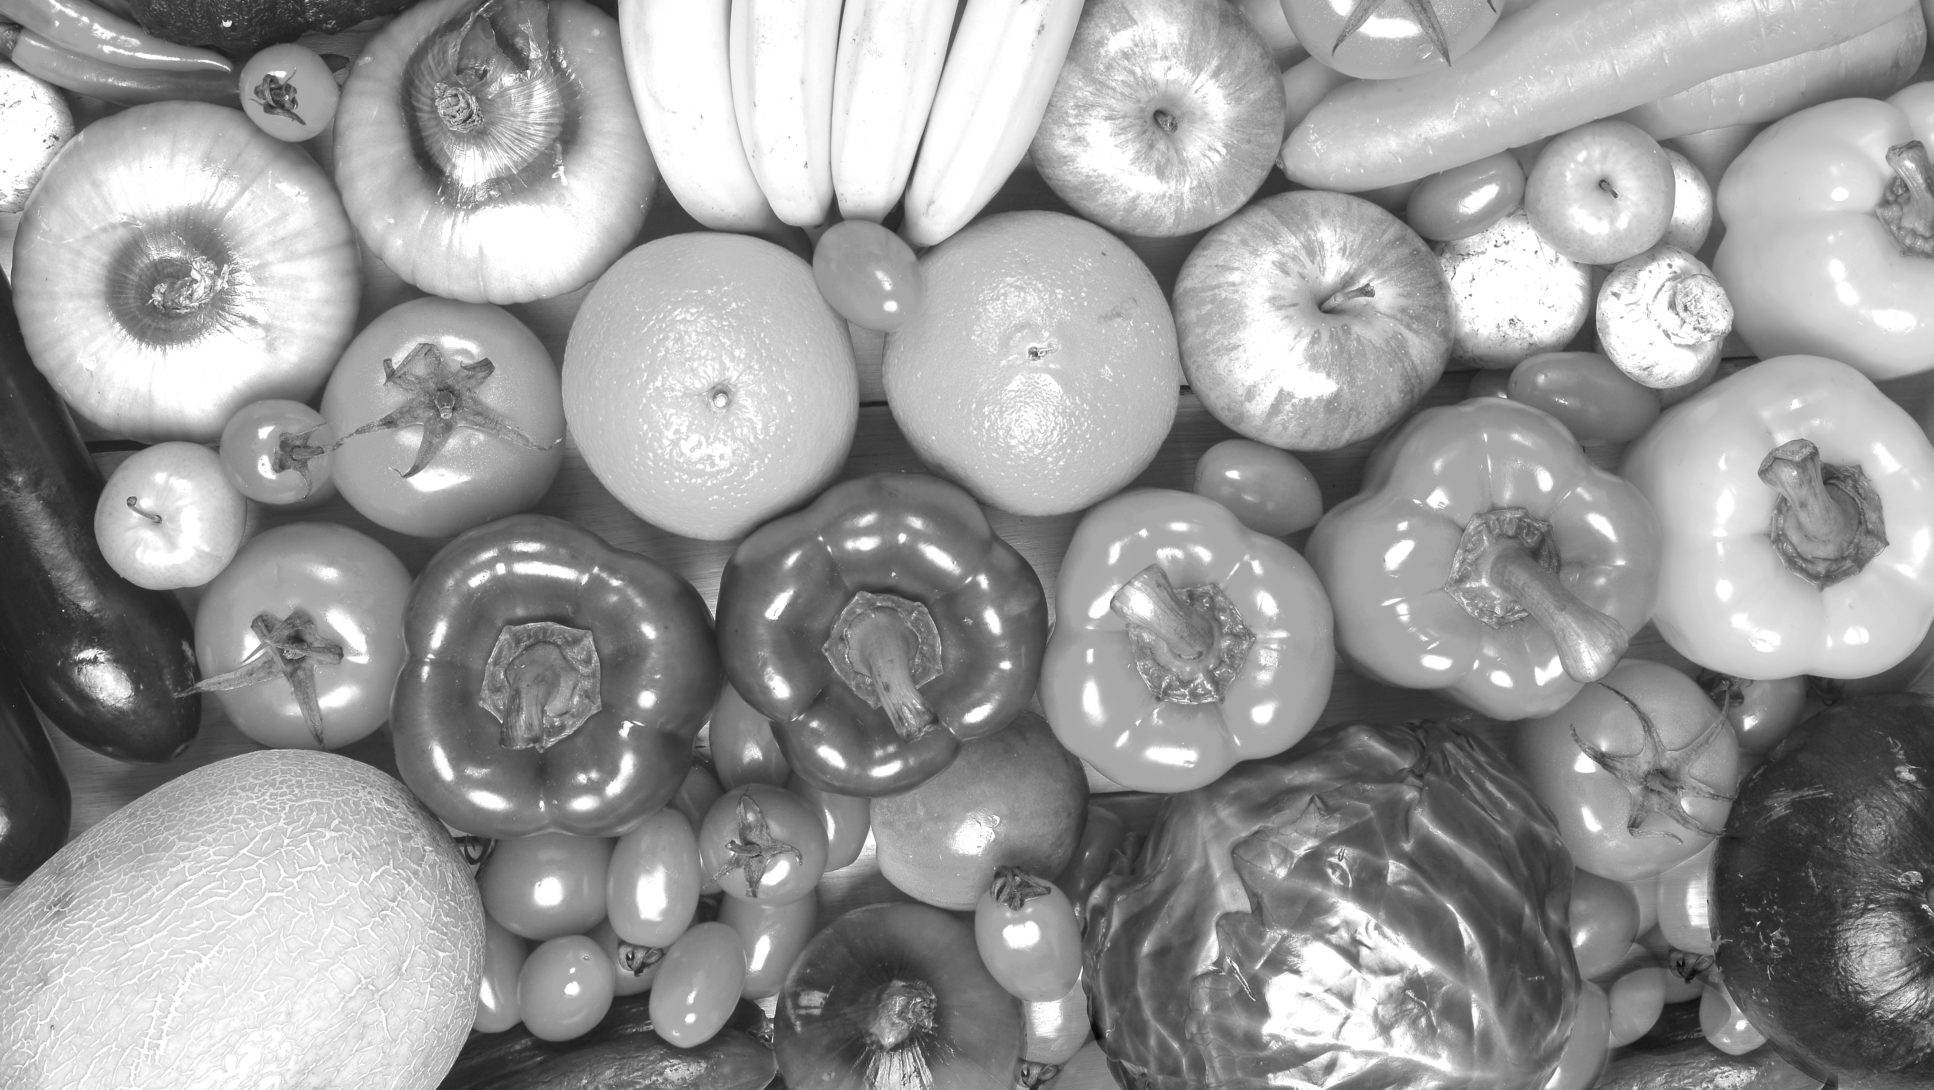
User benefits
Avoid throwing away food: save money and avoid food waste.
Discover new recipes
Fast and easy cooking with step-by-step recipes
Only use limited time for grocery shopping
Buy products in bulk

Slide 6


FUTURE FEATURES.
Additional dietary preferences (e.g. vegan, vegetarian, low-carb) and allergies.
Refrigerator feature to manually add food for recipe suggestions
Integration with home delivery services (e.g. Coop@home)

Slide 7
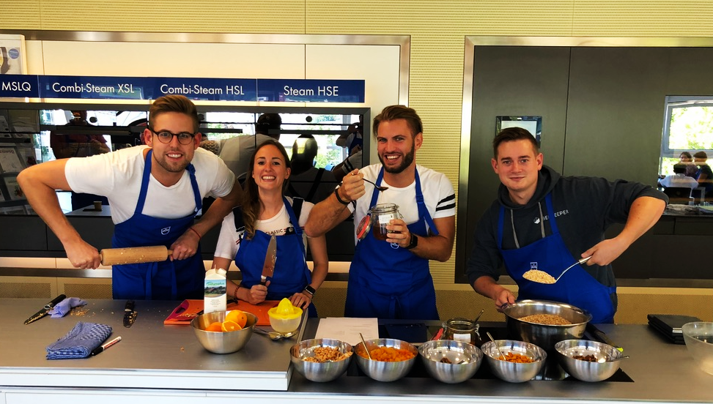
THANK YOU!

